Slide 1
Cognitive Delivery Insights (CDI)
key Insights and their benefits

Slide 2
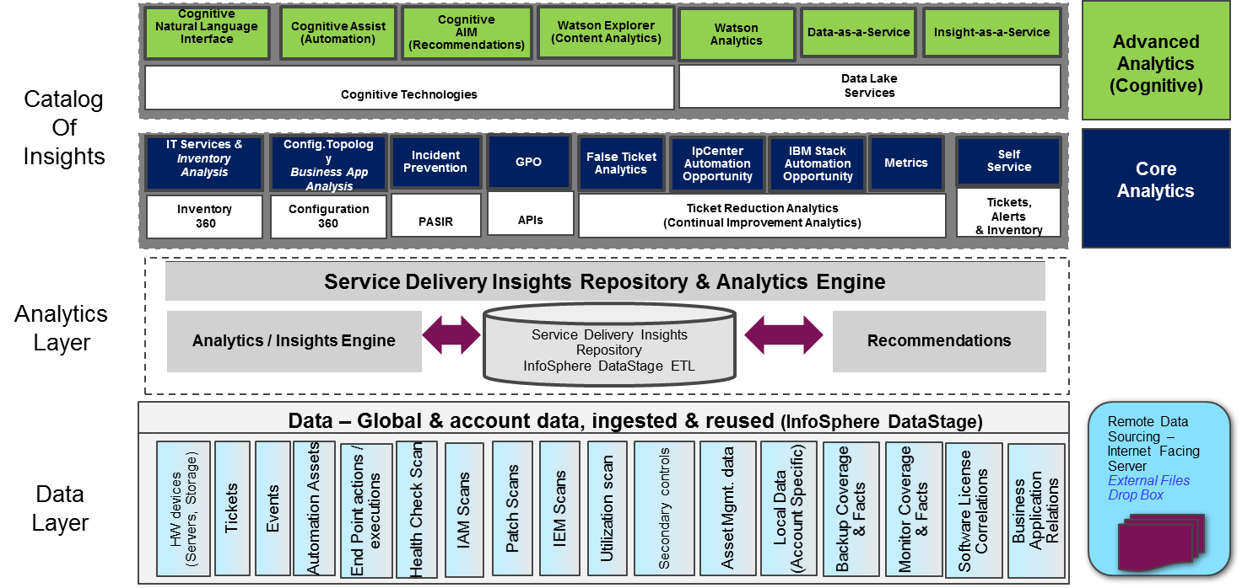
What is Cognitive Delivery Insights?
GTS Cognitive Delivery Insights (CDI) is a platform that is connected to a growing number of data source types (e.g. IPcenter, Netcool, IPC ticketing system) and data source instances. The data from the data sources is regularly pulled by ETLs and stored in the CDI repository. This repository is used by the various available insights, mapped to domains, within the CDI catalog that provides insights for the Service Delivery business to drive cost savings. The variety of data sources is depicted in the overview below.
Client representatives use CDI to understand how their services are performing and where and how to improve.
Cognitive Delivery Insights (CDI) combines multiple data sources to provide business intelligence about client environments.

Slide 3
A number of new Insights have appeared in CDI
The following are new and updated CDI insights enabled in CDI EU:
Transformation Metrics - Summary Dashboard (UPDATED) https://w3-connections.ibm.com/wikis/home?lang=en#!/wiki/Service%20Delivery%20Insights/page/Transformation%20Metrics%20-%20Summary%20Dashboard
Cross Account Transformation Metrics - Summary Dashboard (NEW) https://w3-connections.ibm.com/wikis/home?lang=en#!/wiki/Service%20Delivery%20Insights/page/Cross%20Account%20Transformation%20Metrics
Automation Opportunity Estimator (UPDATED) https://w3-connections.ibm.com/wikis/home?lang=en#!/wiki/Service%20Delivery%20Insights/page/Automation%20Opportunity%20Estimator
Event Triage Analysis (NEW) https://w3-connections.ibm.com/wikis/home?lang=en#!/wiki/Service%20Delivery%20Insights/page/Event%20Triage%20Analysis
Problematic Server Analysis (NEW) https://w3-connections.ibm.com/wikis/home?lang=en#!/wiki/Service%20Delivery%20Insights/page/Problematic%20Server%20Analysis
The links above point to the respective “Learn More” additional information in the CDI Wiki

Slide 4
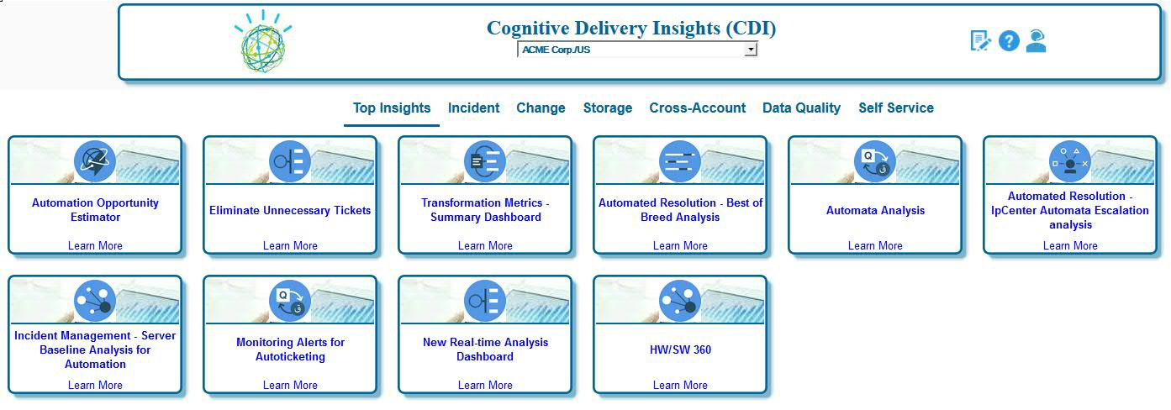
Insights and General Navigation Overview
The following shows how can be navigated through the common dashboard and to select different insights.
Select another account from the drop-down menu (if needed).
The “cross-account” Insights allows for running reports for a Market or Geography. This shows overall roll-up metrics or can be used to compare accounts.
By selecting a different category from the menu bar different insights will be shown in relation to the category label
The “data quality” Insights has reports to validate if all data is coming in for an account and if the data sources are correctly mapped.
The “Learn More” link refers to an external community with additional information (e.g. instructions and how things are computed).
These “tiles” are called insights and, when clicked, open a new report showing details related to the tile label

Slide 5
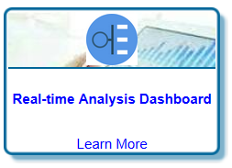
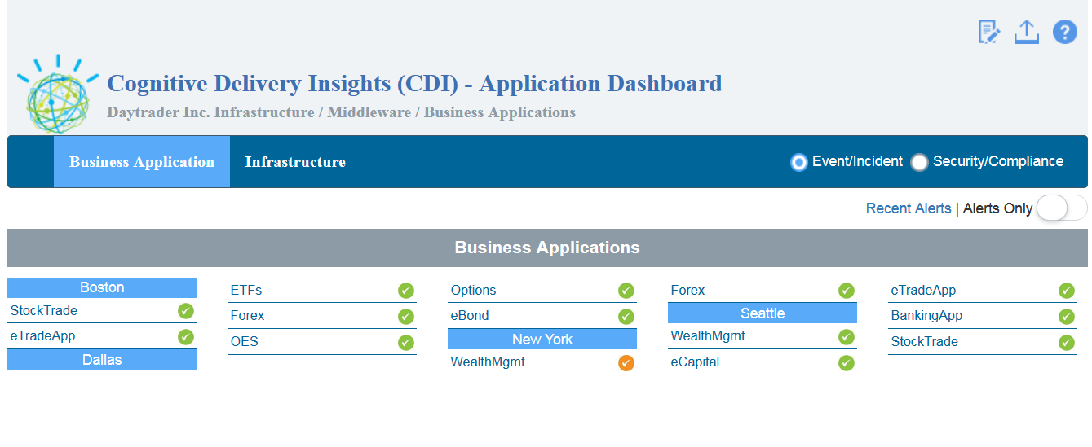
Real Time Dashboard (RTD)
The Real Time Dashboard (RTD) provides an overview of the current active alerts for the client. It shows it grouped by “infrastructure (middleware/application)” as well as grouped by “business application”. The business applications are configured by the account. CDI performs continuous pulls from the systems management environment (reporter database) with a frequency of minutes (automatic refresh).
The Business Applications section shows current open/active events grouped account configured business applications.
The infrastructure section shows current open/active events grouped by infrastructure components.
Upload account configured server to business application mappings*.
Toggle to include/exclude the groups which have “green” severity status.
Click on any label to run the report on servers grouped in the collection.
Three levels of severity shown: Green: Warning or no events
Amber: Minor or major events
Red: Critical events
Source Systems
Messaging Hub
Streaming Funnel
Event Management Systems
Real Time Streaming Data Processing (Data-in-Motion)
CDI Data Lake
Insights provides a real time overview of active events (with ticket) grouped by business application.
* Information how to upload account business application mappings can be found through the (?) help link.

Slide 6
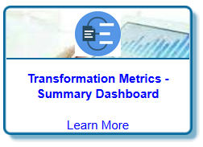
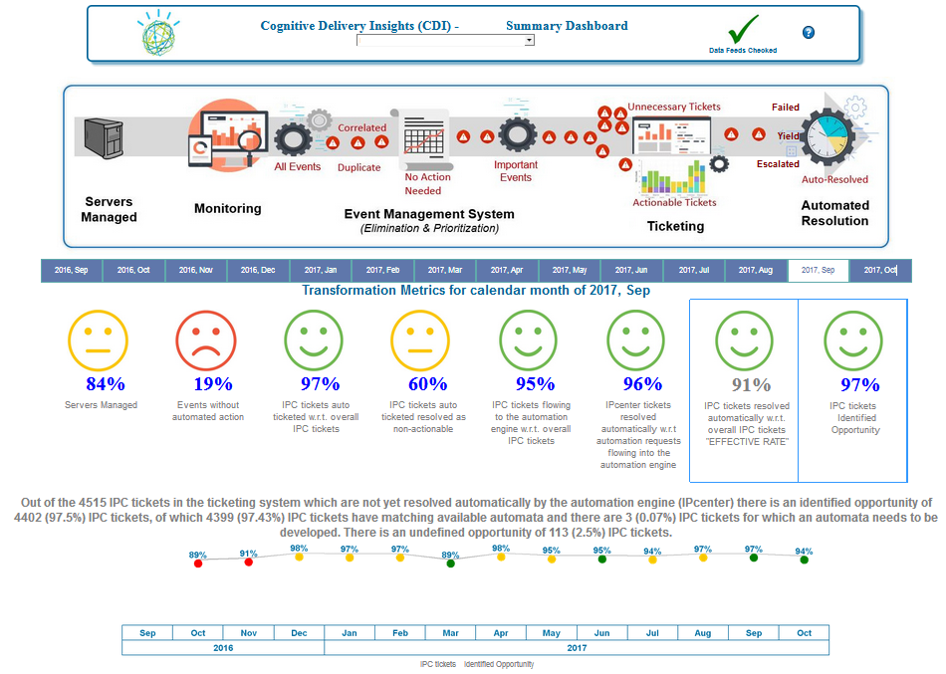
Transformation Metrics – Summary Dashboard
The Transformation Metrics – Summary Dashboard report provides an end-to-end overview how well the account is performing throughout the lifecycle of an event. It leverages asset DB, event, ticket and IPcenter data (sources) to gain overall insight.
Smiley symbol added to this metric called “Effective Rate” which shows the value of automation in relation to all the IPC tickets within the account.
New Smiley to show the IPC tickets identified opportunity which indicates how much automation can be applied to the account (available automate and new automata).
New drill-down into Event Analysis Report to show the incoming events an account and their flow/triage to the event management system
New drill-down report to the Automation Opportunity Estimator report (Opportunity tab) to show what opportunity is there (resolver group, automata etc).
Clicking on the “Smiley” will provide detailed information (numbers used in percentage calculation) and shows the historical trend for the specific metric.

Slide 7
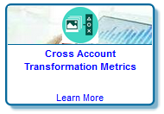
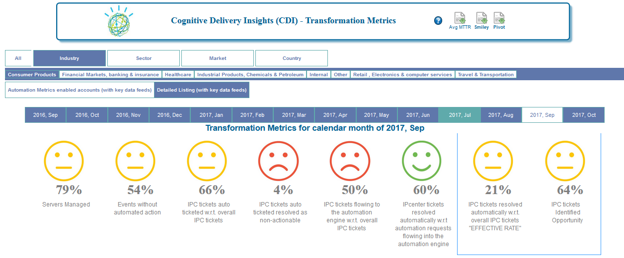
Cross Account Transformation Metrics – Summary Dashboard
The Cross Account Transformation Metrics – Summary Dashboard report provides an end-to-end overview how well the geo, market, country, sector or industry are performing throughout the lifecycle of an event. It leverages asset DB, event, ticket and IPcenter data (sources) to gain overall insight.
Download spreadsheet report (Pivot) to show the information (all smileys etc) for each individual account as well as the rolled-up values for each market, country, industry and sector.
Selection bar to select a specific market, country, industry or sector.
Selection bar to select geo (all), market, country, industry or sector.
Smiley symbol added to this metric called “Effective Rate” which shows the value of automation in relation to all the IPC tickets within the selection.
Selection bar to select to show the current month or any of the last twelve completed months.
There are no drill down report or additional text available for the rolled-up smileys. An account is added to the rolled-up smileys when IPC ticket and IPcenter data is available.
New Smiley to show the IPC tickets identified opportunity which indicates how much automation can be applied (available automate and new automata).

Slide 8
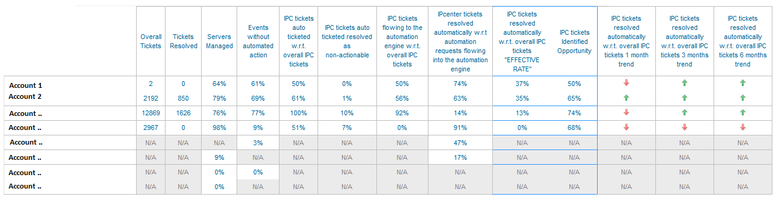
Cross Account Transformation Metrics – Summary Dashboard
The Cross Account Transformation Metrics – Summary Dashboard report provides an end-to-end overview how well the geo, market, country, sector or industry are performing throughout the lifecycle of an event. It leverages asset DB, event, ticket and IPcenter data (sources) to gain overall insight.
Based upon the selection on the top of the report, all individual accounts and their respective metrics are shown.
The trend for the “effective rate” since the last month, since average three months or since average of six months is shown.
Overall IPC tickets and IPC tickets automatically resolved for the account.
All the percentages of the 8th smileys are shown for each of the accounts.
Account list is sorted to the account having the highest “effective rate”.
Smiley symbol added to this metric called “Effective Rate” which shows the value of automation in relation to all the IPC tickets within the account.
All accounts within the selection are shown even if they do not have all data sources available (yet) in CDI.

Slide 9
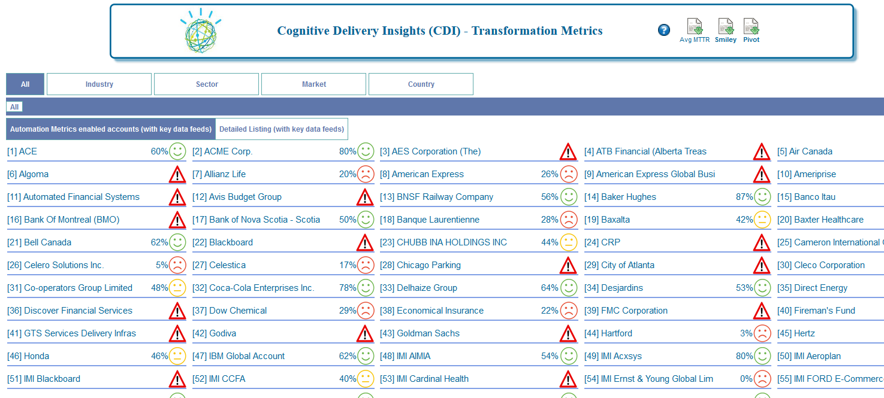
Cross Account Transformation Metrics – Summary Dashboard
The Cross Account Transformation Metrics – Summary Dashboard report provides an end-to-end overview how well the geo, market, country, sector or industry are performing throughout the lifecycle of an event. It leverages asset DB, event, ticket and IPcenter data (sources) to gain overall insight.

Slide 10
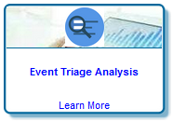
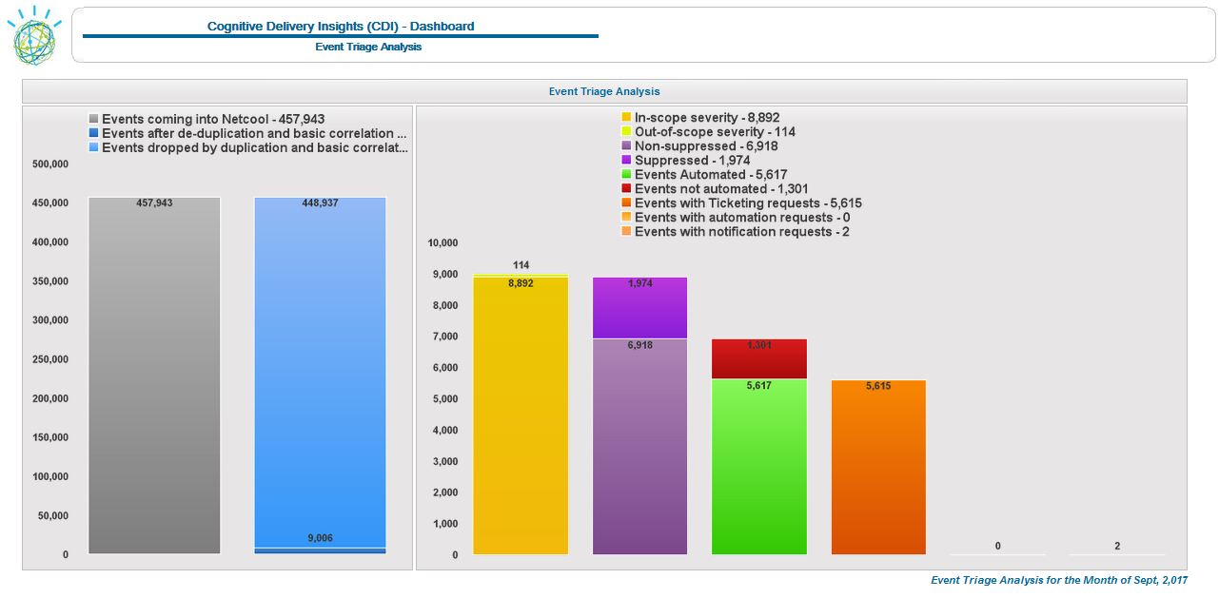
Event Triage Analysis
The Event Triage Analysis shows how the instream of alerts for an account from monitoring is triaged into meaningful events for which automation needs to be performed.
For each account shows the in-stream and out-stream of events through the event management system. Highlighting the value of the event management solution to triage the incoming alerts to meaningful events.
Indicates that maintenance mode is being used on the account.
Shows for how many events ticketing requests, automation requests and notification requests are done. An event may be shown in any combination of the three.
These events are not automated and most likely handled manually by Systems Operations.
Observation is that the ratio between incoming alerts and the events after de-duplication and basic correlation is very high. Therefore the second part of the chart has a different scale.
Phase 2 of this report will enable a drill-down to show event types and servers for the selected metric.

Slide 11
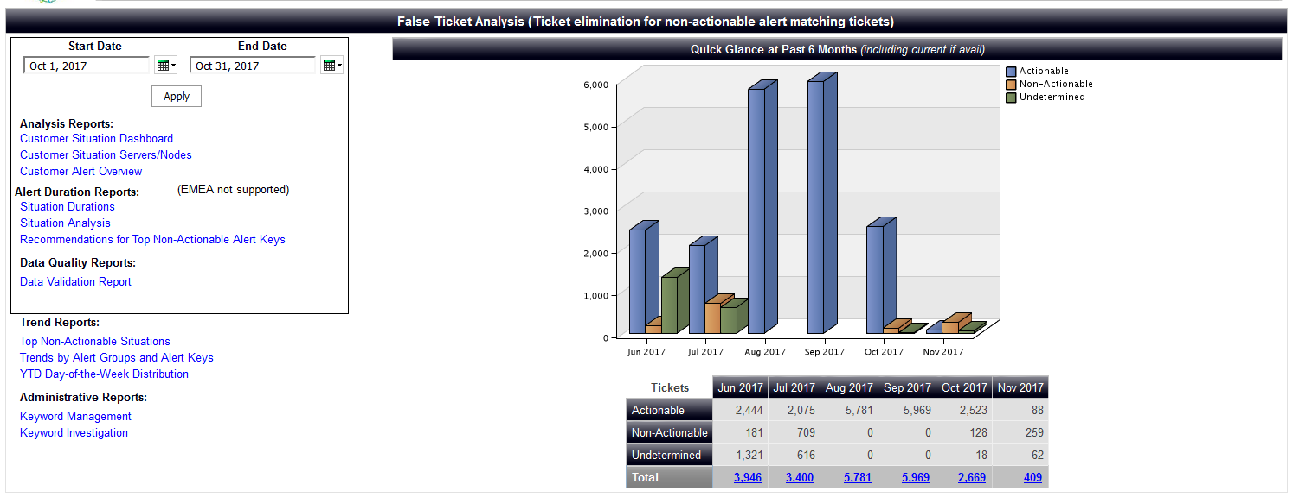
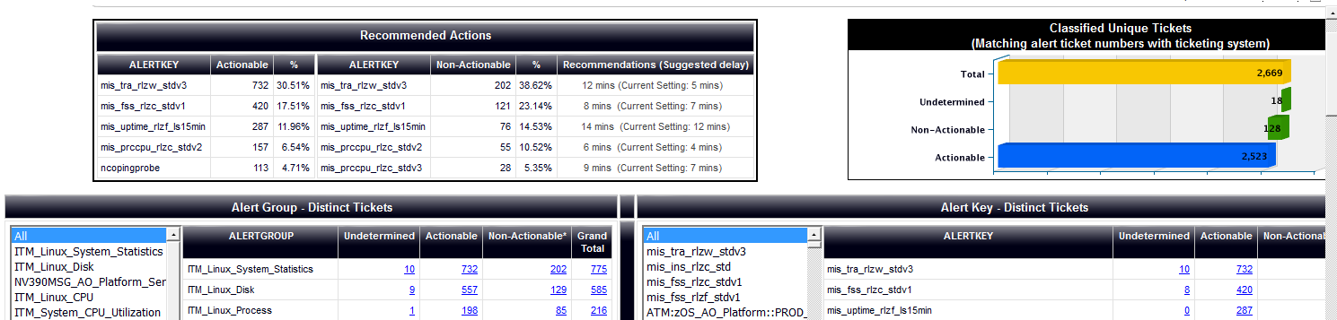
False Ticket Analysis

Slide 12
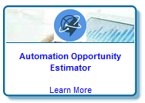
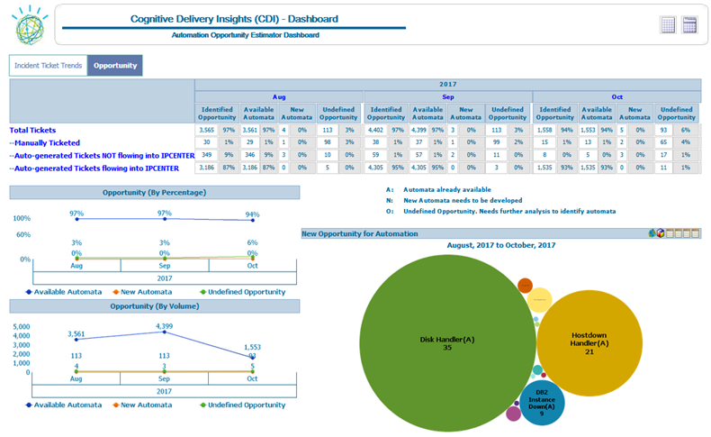
Automation Opportunity Estimator – Opportunity tab
The Automation Opportunity Estimator report shows the Identified Opportunity (Available Automata and New Automata to be developed) and the Undefined Opportunity for IPC tickets generated on the account. It provides insight which automata should be requested to be developed and available automata to be enabled first on the account.
Shows a 3 month view of Identified Opportunity (Available and New Automata) and Undefined Opportunity (IPC tickets currently not understood yet).
Selection tab between “Incident Ticket Trends” view and this “Opportunity” view.
Clicking on these categories will affect which charts are shown in the right bottom corner.
This area has various detailed reports to show which automata (for which resolver groups) should be (developed and) enabled first .
Shows the trend of the “Available Automata”, “New Automata” and “Undefined Opportunity for the account for the selected month and the two previous months.
Shows the opportunity for each of the accounts in terms of identified opportunity of automation to enable.

Slide 13
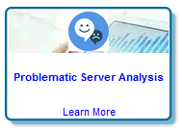
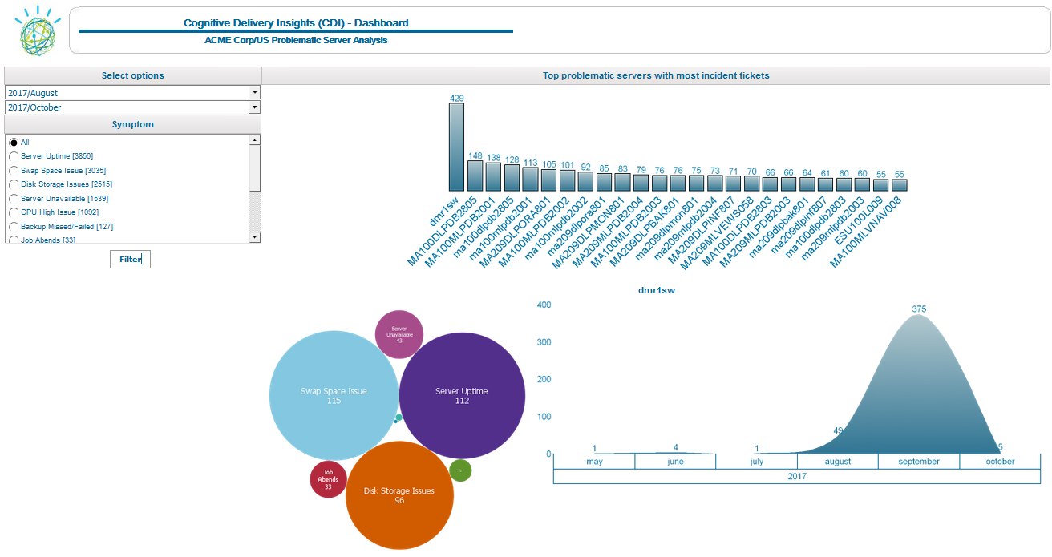
Problematic Server Analysis (WIP)
The Problematic Server Analysis shows per symptom (or for all symptoms) which servers of an account are impacted by it. The detailed view shows the occurrences of these symptoms and their distribution over time.
By clicking on a server shows the bubble chart and the trend chart.
Single or multiple months can be selected to run the report for.
Possibility to show the report for all symptoms or a specific symptom (to show servers are impacted).
The bubble chart show the most significant symptom as the largest bubble.
The trend chart shows the volume of the types of symptoms selected for the selected server.
For each account shows the problematic servers and symptoms that frequently occur on them.

Slide 14
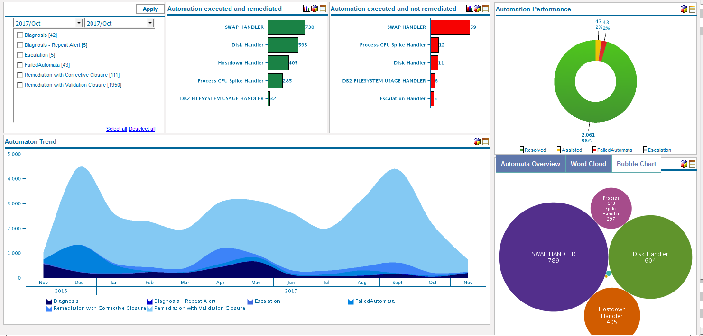
Automata Analysis
This Insight provide a detailed analysis on the performance of the automations being run for an account.

Slide 15
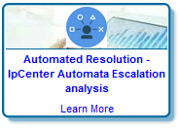
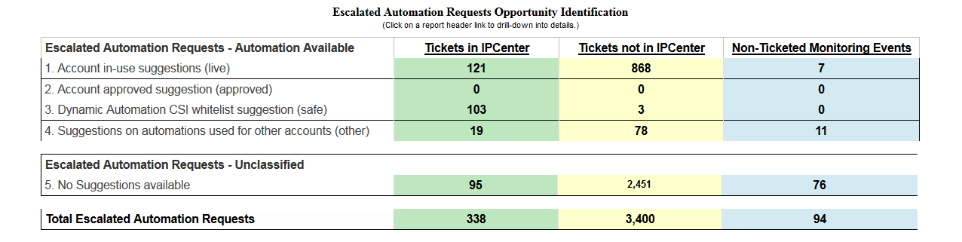
Automated Resolution - IpCenter Automata Escalation analysis
This insight shows additional yield opportunity for escalated IPcenter tickets, IPC system ticketed events not flowing to IPcenter and non-ticketed events not flowing to IPcenter. Event, ticket and IPcenter data sources are used to match these to existing automations. Forwarding of additional events and tickets to IPcenter, as well as correct mapping of these type of events/tickets to automations will increase overall yield for the account.
Distributed/MF to ensure that all actionable events are auto-tickets, ticketable events are sent to IPcenter. And that IPcenter is setup to run available automation.
For this they may need to work together with CSI and SMI teams.
IPcenter Ticketed
These alerts are ticketed and flowing to IPcenter, but do not match an automata yet.
There are automations available within the IPcenter instance (for same or different account) that could be used to automate these types of alerts.
Non-IPcenter Ticketed
These alerts are ticketed but not forwarded to IPcenter.
Human (L2) resources will be handling those tickets manually.
In this example about 10% of these tickets match an existing automata which would reduce the workload significantly.
Non-Ticketed Alerts
These alerts are not ticketed nor forwarded to IPcenter.
There is no 1:1 (event:ticket) relationship. On average a 10:1 ratio can be expected. Which can be matched to existing automata.
Expected workload savings may vary per account as these may currently be ignored or handled by SysOps.
Forwarding these alerts will reduce SysOps work and may prevent issues from happening on the system reported by WARNING alerts.
Delivery Analysts (DA) needs to focus on these numbers (especially the one in green) to identify additional yield opportunity in the account.

Slide 16
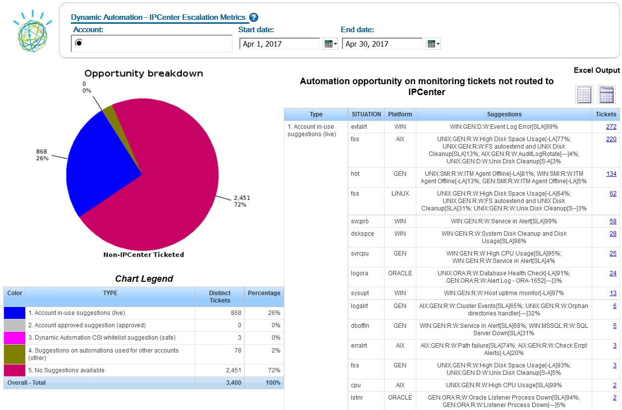
Automated Resolution - IpCenter Automata Escalation analysis Level 1 – Drill Down
This reports shows a detailed view which situations (AlertKey) match specific automations. The account team (DA) uses this report to further drill down in the events/tickets involved. Work with the CSI team to get these type of events/tickets automatically resolved by reviewing/approving SOPs and updating the IPcenter matching rules.
Detailed report per AlertKey (situation type) matching specific automations available in IPcenter for current or other accounts.
Date range selection..
Clicking on a number provides detailed information for actual events/tickets involved.
There is a large percentage of tickets sent to IPcenter that currently are escalated but for which there could be automations available.
Delivery Analysts (DA) uses this detail to identify the largest additional yield opportunity in the account.
* Similar reports are available for IPC system ticketed events not flowing to IPcenter and non-ticketed events not flowing to IPcenter

Slide 17
“Learn More” additional information in the CDI Wiki
Area | Description
Access Management | You will find details here Or: https://w3-connections.ibm.com/wikis/home?lang=en-us#!/wiki/W792382fe62dd_4a4f_823c_93d42daa2978/page/GTS-CDI%20Requesting%20User%20Access NB: You will need approval from your Functional manager
CDI Europe instance Production link | This is the link to be used: http://gtssdi-eur-prod.w3cloud.ibm.com/sdi/cgi-bin/cognos.cgi This is the direct IP address URL for EMEA Prod (this may be used if there is DNS issue): http://146.89.187.80/sdi/cgi-bin/cognos.cgi
Navigation Instructions | You will find instructions on how to navigate on the website here Or: https://w3-connections.ibm.com/wikis/home?lang=en-us#!/wiki/W792382fe62dd_4a4f_823c_93d42daa2978/page/CDI%20Navigation%20Overview
Education on CDI | You will find useful materials on Metric KPI description & videos, and the CDI Roadmap here Education: https://w3-connections.ibm.com/wikis/home?lang=en-us#!/wiki/W792382fe62dd_4a4f_823c_93d42daa2978/page/Education%20Materials Metric/ KPI description: https://w3-connections.ibm.com/wikis/home?lang=en-us#!/wiki/W792382fe62dd_4a4f_823c_93d42daa2978/page/CDI%20Metric%20KPI%20Descriptions Educational videos: https://w3-connections.ibm.com/wikis/home?lang=en-us#!/wiki/W792382fe62dd_4a4f_823c_93d42daa2978/page/Introduction%20to%20CDI%20-%20Video%20Presentation
Known Issues | You will find information on known issues here Or: https://w3-connections.ibm.com/wikis/home?lang=en-us#!/wiki/W792382fe62dd_4a4f_823c_93d42daa2978/page/GTS-CDI%20Known%20Issues
Report a defect | You can report a defect here Or: https://w3-connections.ibm.com/wikis/home?lang=en-us#!/wiki/W792382fe62dd_4a4f_823c_93d42daa2978/page/GTS-CDI%20%20-%20Report%20a%20Problem
Ideation blog for feedbacks | You can find the ideation blog here Or: https://w3-connections.ibm.com/communities/service/html/communityoverview?communityUuid=01328406-a6c9-4e77-a0c1-552def94dd74#fullpageWidgetId=W1c2c5be90945_4f64_bacb_7c279d2b5605

Slide 18
Q&A

